Slide 1


Lecture 9
Printers and Scanners
CT4005NI - Computer Hardware and Software Architectures

Slide 2

Introduction
This chapter provides essential information about printers and scanners
Printers produce paper copies of electronic files.
Scanners allow users to convert paper documents into electronic files.
Objectives
Describe the types of printers currently available.
Describe the installation and configuration process for printers.
Describe the types of scanners currently available.
Describe the installation and configuration process for scanners.
Identify and apply common preventive maintenance techniques for printers and scanners.
Troubleshoot printers and scanners.

Slide 3

Characteristics and capabilities of printers
Capacity and speed
Color or black and white
Quality
Reliability
Warranty
Scheduled servicing
Mean Time Between Failures(MTBF)
Total cost of ownership
Initial Purchase price
Cost of supplies(paper, ink)
Maintenance and warranty costs

Slide 4
Printer to computer interfaces
A computer must have a compatible interface with the printer to be able to print documents. Typically, printers are connected through the following interfaces:
Serial
Parallel
SCSI
USB
Fire wire
Ethernet
Wireless

Slide 5
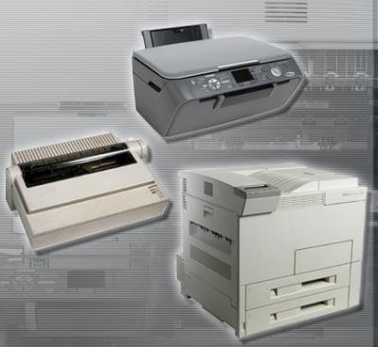
Printers and Its types
A printer is a device that accepts text and graphic output from a computer and transfers the information to paper, usually to standard size sheets of paper. Printers vary in size, speed, sophistication, and cost.
The Types of printer are:
Laser Printer
Impact Printer
Ink jet Printer
Solid ink Printer

Slide 6
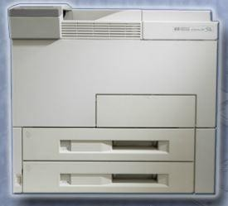
Laser Printer
A laser printer is a high-quality, fast printer that uses a laser beam to create an image.
. As the drum rotates, the laser beam draws an electrostatic image upon the drum, called the image. The undeveloped or latent image is passed by a supply of dry ink or toner that is attracted to it.
The drum turns and brings this image in contact with the paper, which attracts the toner from the drum. The paper is passed through a fuser that is made up of hot rollers, which melts the toner into the paper.

Slide 7
Printing Process
Cleaning
Conditioning
Writing
Developing
Transferring
Fusing

Slide 8
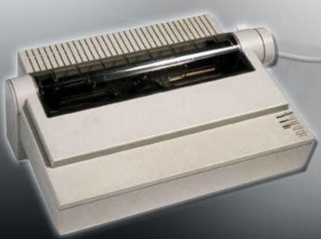
Impact Printer
Impact printers are very basic printers. Impact printers have print heads that strike the inked ribbon, causing characters to be imprinted on the paper. Dot matrix and daisy wheel are examples of impact printers.
The following are some advantages of an impact printer:
•
•
•
Uses inexpensive consumables Uses continuous feed paper Has carbon-copy printing ability
The following are some disadvantages of an impact printer:
•
•
•
•
Noisy
Low-resolution graphics
Limited color capability
Slow printing, normally in the range of 32 to 76 characters per second (cps)

Slide 9
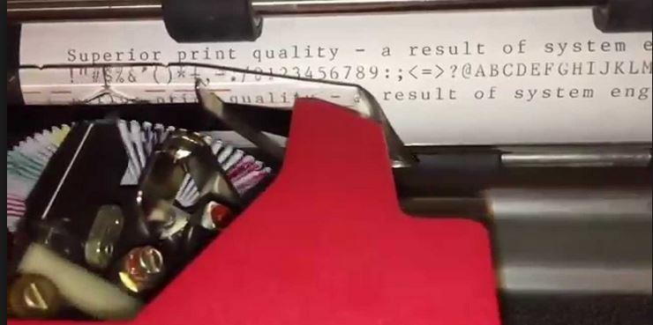
Types of Impact Printer
Daisy Wheel Printer
the wheel contains the letters, numbers, and special characters.
The wheel is rotated until the required character is in place, and an electromechanical hammer pushes the character into the ink ribbon.
The character then strikes the paper, imprinting the character on the paper

Slide 10
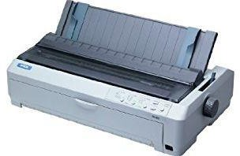
Dot Matrix Printer
a print head contains pins that are surrounded by electromagnets.
When energized, the pins push forward onto the ink ribbon, creating a character on the paper.
The number of pins on a print head, 9 or 24, indicates the quality of the print.
The highest quality of print that is produced by the dot matrix printer is referred to as near letter quality (NLQ).

Slide 11
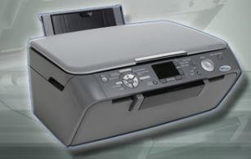
Ink Jet Printers
Inkjet printers use ink-filled cartridges that spray ink onto a page through tiny holes
The tiny holes are called nozzles.
The ink is sprayed in a pattern on the page.
The print quality of an inkjet printer is measured in dots per inch (dpi).
some advantages of an inkjet printer:
Low cost
High resolution
Quick to warm up
some disadvantages of an inkjet printer:
Nozzles are prone to blocking.
Ink cartridges are expensive.
Ink is wet after printing.
.

Slide 12

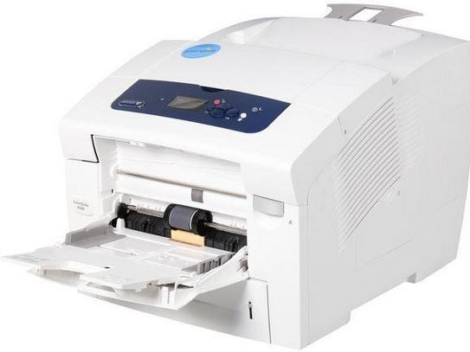
Solid ink printers
Solid-ink printers use solid sticks of ink rather than toner or ink cartridges.
Solid-ink printers produce high-quality images.
The ink sticks are nontoxic and can be handled safely.
Solid-ink printers melt ink sticks and spray the ink through nozzles. The ink is sprayed onto a drum. The drum transfers the ink to paper.
advantages of solid-ink printers:
Produces vibrant color prints
Easy to use
Can use many different paper types
disadvantages of solid-ink printers:
Printers are expensive.
Ink is expensive.
They are slow to warm up

Slide 13
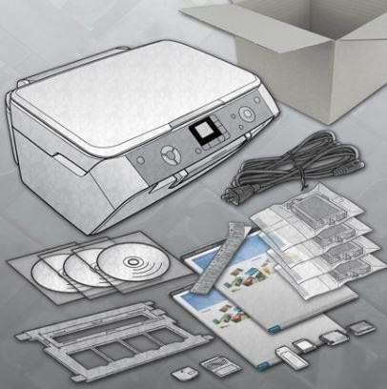
Installation and configuration process of printers
•
•
•
•
•
•
•
Describe how to set up a printer
Explain how to power and connect the device using a local or network port. Describe how to install and update the device driver, firmware, and RAM.
Identify configuration options and default settings. Describe how to optimize printer performance.
Describe how to print a test page. Describe how to share a printer.

Slide 14
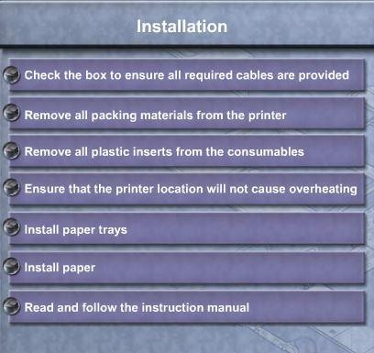
Describe how to set up a printer

Slide 15
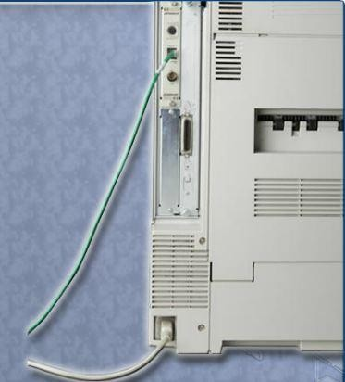
Explain how to power and connect the device using a local or network port
A printer can be connected and used as a local or network printer.
The local computer manages and sends the print jobs to the printer. Local printers can be shared over the network with other users.
. A network printer is connected to a network using a wireless or an Ethernet connection.
The network printer allows multiple users to send documents to
the printer over the network
After determining types of printer connect the appropriate data and power port.

Slide 16
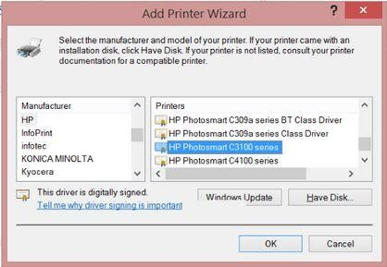
Describe how to install and update the device driver, firmware and RAM
After you have connected the power and data cables to the printer, the operating system might discover the printer and attempt to install a printer driver.
Step1- Find Out If a Newer Driver Is Available
Step2 - Download the driver
Step3 - Install the downloaded driver
Step4 - Test the new printer driver
Firmware is a set of instructions stored on the printer. The firmware controls how the printer operates.
Printer Memory
Adding printer memory to a printer can improve printing speed and allow the printer to handle
more complex print jobs. All printers have at least some amount of memory inside.

Slide 17
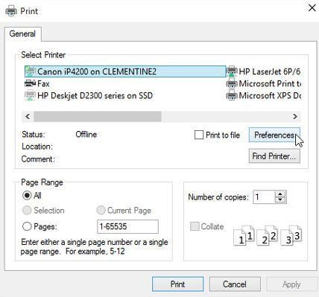
Identify configuration options and default settings
some common configurations that are available for printers:
•
•
•
•
•
Paper type – standard, draft, gloss, or photo Print quality – draft, normal, photo, or automatic Color printing – multiple colors used
Black-and-white printing – only black ink used
Grayscale printing – color image printed using only black ink in different shades
Paper size – standard paper sizes or envelopes and business cards Paper orientation – landscape or portrait
Print layout – normal, banner, booklet, or poster
Duplex – normal or two-sided printing
•
•
•
•

Slide 18
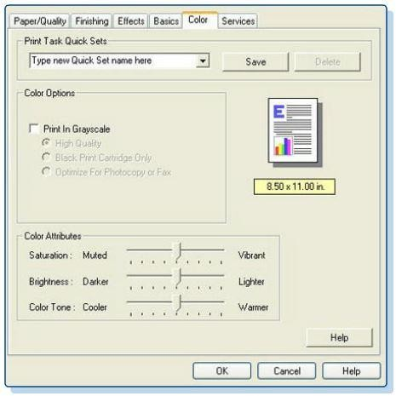
Describe how to optimize performance
With printers, most optimization is completed through the software supplied with the drivers.
In the software, there are tools available to optimize performance:
•Print spool settings – Cancel or pause current print jobs in the printer queue
•Color calibration – Adjust settings to match the colors on the screen to the colors on the printed sheet
•Paper orientation – Select landscape or portrait image layout

Slide 19
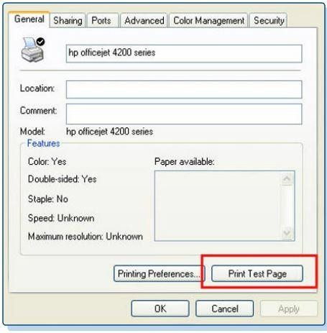
Describe how to print a test page
After installing a printer, you should print a test page to verify that the printer is operating properly. Print a test page manually
In Windows 10
Control panel
Go to Device and printers and right click your printer
Go to printer’s properties
Under the general tab, click print test page.
Print from an application
Start > All Programs > Accessories > Notepad In blank document type some text and print it.
Print from command line
Start > run > cmd > type command “print thefile.txt”

Slide 20
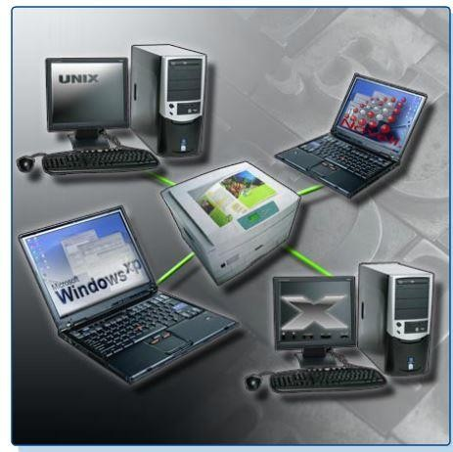
Describe how to share a printer
Printer sharing enables multiple users or clients to access a printer that they are not directly connected.
Go to control panel
Click hardware and sounds
Click on devices and printers
Select your printer and right click on it
Click on sharing
Check on “share this printer”
Keep or change the share name
Click apply

Slide 21
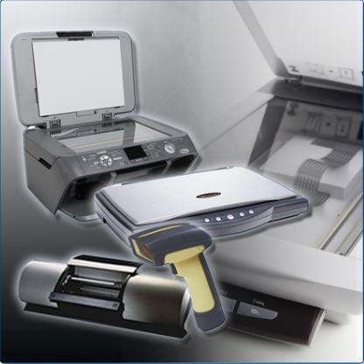
Scanners
Scanners convert printed data or images into an electronic data format that a computer can store or process as required.
After an image has been scanned, it can be saved, modified, and even e-mailed
Scanners typically create an RGB image that can be converted into common image formats such as JPEG, TIFF, BMP, and PNG.
The resolution of a scanner is measured in dots per inch (dpi).
Like printers, the higher the dpi, the better the quality of the image.
interfaces and cables used for printers are typically the same as the interfaces and cables used for scanners

Slide 22
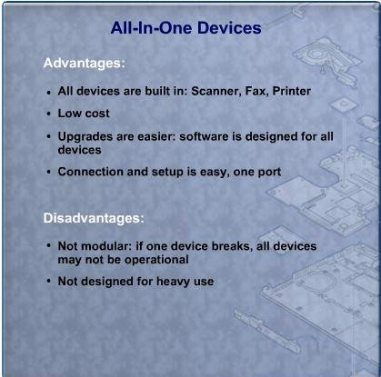
All in one devices
An all-in-one device combines the functionality of multiple devices into one physical piece of
hardware.
All-in-one devices generally include these functions:
•
•
•
•
Scanner Printer Copier Fax

Slide 23
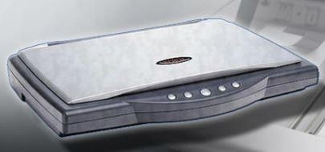
Types of scanner Flat bed scanner
Flatbed scanners are often used to scan books and photographs for archiving
The scanner head, consisting of an array of image sensors, lies beneath the glass and moves along
the item, capturing the image
Sheet feeders can be used with flatbed scanners to scan multiple images.

Slide 24
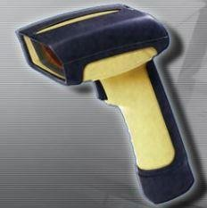
Handheld scanner
A handheld scanner is small and portable
To scan an item, carefully pass the scanner head across the item that you want to scan
When you want to scan an item larger than the head of the handheld scanner, you must make
more than one pass to capture the full image.

Slide 25
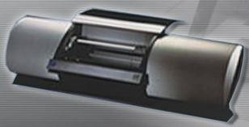
Drum Scanner
Drum scanners produce a high-quality transfer of an image. Drum scanners are usually used
commercially but are being replaced by lower-priced, high-quality flatbed scanners.
To scan an image using a drum scanner, you attach the image to a revolving drum or load it into a supporting canister
The optical scanners move slowly across the drum surface until the entire image is captured

Slide 26
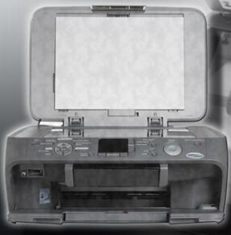
Describe the installation and configuration process for scanners
•
•
•
Explain how to power and connect a scanner. Describe how to install and update the device driver. Identify configuration options and default settings

Slide 27
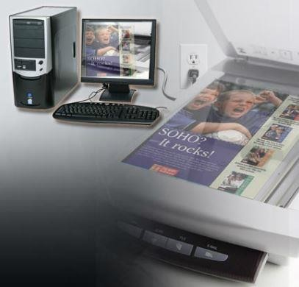
Explain how to power and connect a scanner
scanners can connect to a computer using the USB, FireWire, network, or parallel port interface
all-in-one device are plugged directly into an AC wall outlet. Other types of scanners acquire power through the USB or FireWire connector
Use the scanner documentation as your guide, or check the manufacturer's website for instructions.

Slide 28
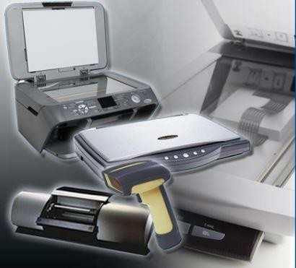
Install and update device driver
Install the driver software that the manufacturer includes with the scanner
you might want to install drivers from the manufacturer's website to gain additional functionality, diagnostic tools, and troubleshooting utilities.
Download software from the manufacturer's website and follow any directions provided to install
the software and utilities for your scanner.

Slide 29
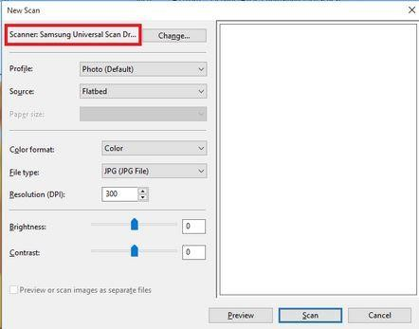
Identify configuration options and default settings
•
•
•
•
Color, grayscale, or black-and-white scanning One-touch scanning into your choice of software Quality and resolution choices
Sheet feeders

Slide 30
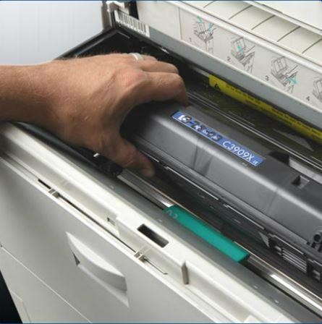
Identify and apply common preventive maintenance techniques for printers and scanner
Printer’s Maintenance:
Printers have many moving parts and require a higher level of maintenance than most other electronic devices.
unplug the printer from the electrical source
printers come with printer monitoring and diagnostic software from the manufacturer that can help you maintain the printer
type and quality of paper and ink used can affect the life of the printer
Paper selection – High-quality paper can help to ensure that the printer operates efficiently and for a long time.
Ink selection – The manufacturer recommends the brand and type of in k to use. If the wrong type of ink is installed, the printer might not work

Slide 31
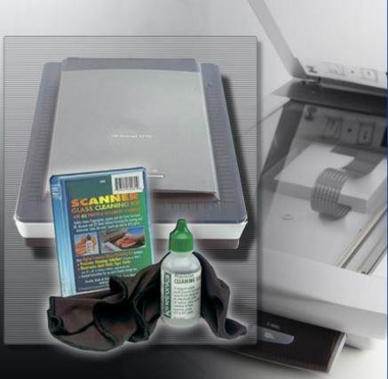
Describe scanner maintenance
scanner surface should be kept clean
consult the manufacturer's user manual for cleaning recommendations
When the scanner is not in use, keep the lid closed.
Put handheld scanners in a safe place.
Also, never lay anything heavy on a scanner because you can damage
the casing or internal parts.

Slide 32
END OF LECTURE 10

